Slide 1
Colorization using similar image
石邢越小组

Slide 2
Agenda
Introduction
Algorithm
Core codes
Demonstration
Problem and possible solution
Reference

Slide 3
Introduction
Related work
User-defined colorization
Colorization using neural networks (large-scale learning)
Target
User doesn’t need to specify each color
Colorize image referring to another similar image
Implement
C/C++
MFC(Microsoft Foundation Classes)
Notes:
项目实现的内容不同于“用户选色”，它不用用户给每一块区域选定颜色（时间富余也可以展示一下用户选色的软件）。
也不同于大规模的神经网络学习后的自动着色，这个项目只是使用一张用户提供的相似的图片，而不是在大量的训练集中搜索相似的图片来学习。这样的实现难度更小，也不需要长时间的训练，当然了，智能程度也是差了一大截。代码量比较小。
用C++和MFC实现，不需要安装torch，opencv等其他依赖项，便于移植。

Slide 4
Algorithm – overview
Color space conversion – RGB to lab
Why?
Color processing
Using mean and standard deviation
Color space conversion – lab to RGB
Why?
How?
How?

Slide 5

Algorithm – gray-scale images and color spaces
Gray-scale images vary along only one dimension (luminance or intensity)
Usually 8 bits depth
$2^{8}$ different colors
Colored image in RGB space has 3-dimensional pixel luminance
Usually 24 bits depth
$2^{24}$ different colors
To add colors to a gray-scale image, we need to assign pixel data in three dimensions.
Thus colorization have no “standard” or “correct” output

Slide 6
Algorithm – gray-scale images and color spaces
Convert images into lab space
For gray-scale images
The luminance dimension of gray-scale image is the l dimension in lab space
For colored images (RGB)
Matrix production (elements of matrices are standardized by institutions)

Slide 7
Algorithm – space conversion (RGB to lab)
Why do we need space conversion?
There are correlations between the different channels’ values in RGB space. So when trying to modify the appearance of a pixel’s color in a coherent way, all color channel need to be modified in tandem, leading to complexity.
Lab space minimizes correlation between channels for many natural scenes so that we can apply different operations in each color channel.
How to implement space conversion from RGB to lab?
Method mentioned in Color transfer between Images and Colorization of gray scale images in lαβ color space using mean and standard deviation [1][6]
Method we adapt [8][9]

Slide 8
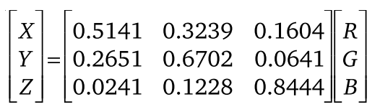
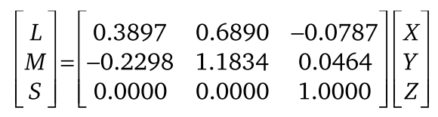
Algorithm – conversion method 1
Reinhard, Erik, et al. "Color transfer between images." IEEE Computer Graphics and Applications 21.5 (2001): 34-41.
Step1. From RGB to XYZ
Step2. From XYZ to LMS

Slide 9
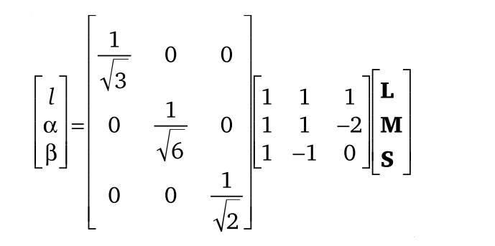
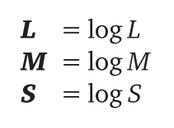
Algorithm – conversion method 1
Step3. convert into logarithmic space
(to reduce great skew)
Step4. convert to lab space

Slide 10

Algorithm – conversion method 2
RGB Working Space: similar to sRGB
Step1. From RGB to XYZ
$$\left[\begin{matrix}X \\ Y \\ Z\end{matrix}\right]=\left[\begin{matrix}0.412453 & 0.35780 & 0.180423 \\ 0.212671 & 0.715160 & 0.072169 \\ 0.019334 & 0.119193 & 0.950227\end{matrix}\right]\left[\begin{matrix}R \\ G \\ B\end{matrix}\right]$$

Slide 11
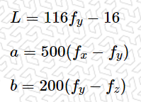
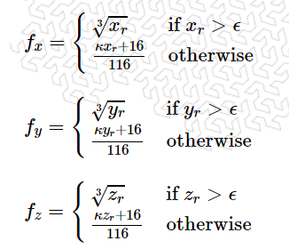
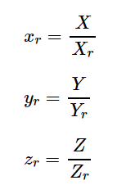
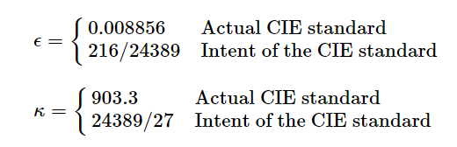
Algorithm – conversion method 2
Step2. From XYZ to lab

Slide 12
Algorithm – color processing
1 2 3 4 5 | for(long i=0;i<sh*sw*3;i=i+3){ sLAB[i]=tl_StdError/sl_StdError*(sLAB[i]-sl_means)+tl_means; sLAB[i+1]=ta_StdError/sa_StdError*(sLAB[i+1]-sa_means)+ta_means; sLAB[i+2]=tb_StdError/sb_StdError*(sLAB[i+2]-sb_means)+tb_means; }

Slide 13
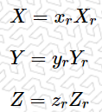
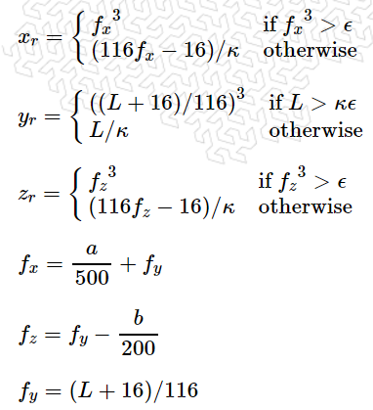
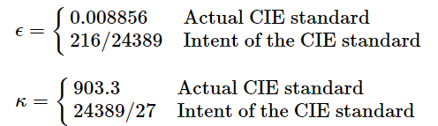
Algorithm – space conversion (lab to RGB)
Return to RGB so that the coloized image can be displayed.

Slide 14
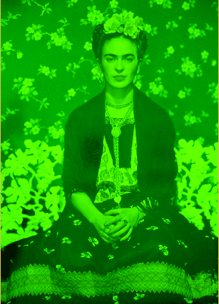
Algorithm – space conversion (lab to RGB)
Oops!
When there are mistakes during the conversion from lab to RGB

Slide 15
Core codes
1 2 3 4 5 6 7 8 9 10 11 12 13 | void CColorization2ImagesView::OnColor() { CColorization2ImagesDoc* pDoc = GetDocument(); ASSERT_VALID(pDoc); if (!pDoc) return; int sh=pDoc->sbmp->infoHead.height; int sw=pDoc->sbmp->infoHead.weidth; int th=pDoc->tbmp->infoHead.height; int tw=pDoc->tbmp->infoHead.weidth; double* sLAB=new double[sh*sw*3]; double* tLAB=new double[th*tw*3];

Slide 16
1 2 3 4 5 6 7 8 9 10 11 12 13 14 15 16 17 18 19 20 21 22 23 24 | //space conversion - RGB to lab transLAB(pDoc->sbmp->data,sw ,sh,sLAB); transLAB(pDoc->tbmp->data,tw ,th,tLAB); //color processing - the standard deviation and mean of the image to be colorized double sl_means,sa_means,sb_means; double sl_StdError,sa_StdError,sb_StdError; getMeans(sLAB,sh*sw,sl_means,sa_means,sb_means); getStdError(sLAB,sh*sw,sl_StdError,sa_StdError,sb_StdError,sl_means,sa_means,sb_means); //color processing - the standard deviation and mean of the target image double tl_means,ta_means,tb_means; double tl_StdError,ta_StdError,tb_StdError; getMeans(tLAB,th*tw,tl_means,ta_means,tb_means); getStdError(tLAB,th*tw,tl_StdError,ta_StdError,tb_StdError,tl_means,ta_means,tb_means); for(long i=0;i<sh*sw*3;i=i+3){ sLAB[i]=tl_StdError/sl_StdError*(sLAB[i]-sl_means)+tl_means; sLAB[i+1]=ta_StdError/sa_StdError*(sLAB[i+1]-sa_means)+ta_means; sLAB[i+2]=tb_StdError/sb_StdError*(sLAB[i+2]-sb_means)+tb_means; } //space conversion - lab to RGB transRGB(pDoc->sbmp->data,sw,sh ,sLAB);
Notes:
The core part of color processing. This part is corresponding to the overview.

Slide 17
1 2 3 4 | reDlg.setBMP(pDoc->sbmp); reDlg.Create(IDD_DIALOG_RESULT) ; reDlg.ShowWindow(SW_SHOW); }

Slide 18
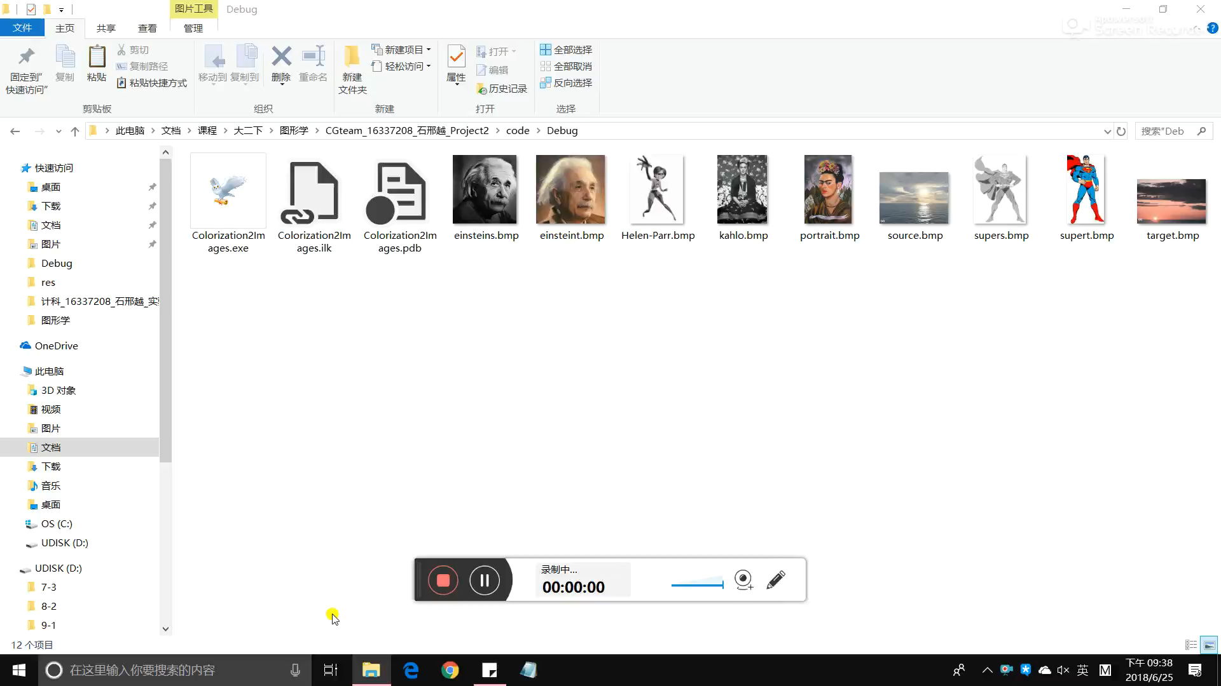
Demonstration – video

Slide 19
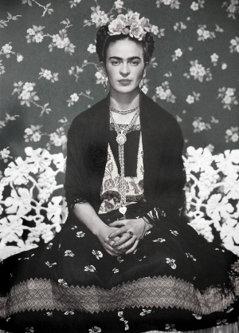
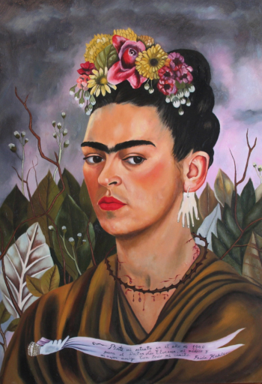
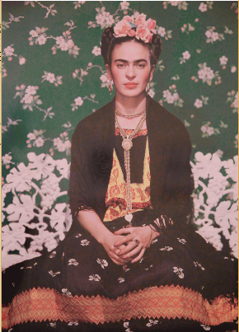
Demonstration – images
Figure1-a. image to colorize
Figure1-b. target
Figure1-c. result

Slide 20
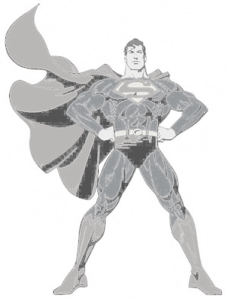
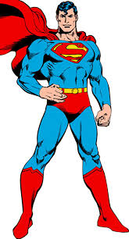
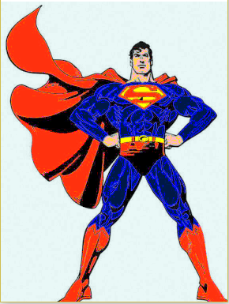
Demonstration – images
Figure2-a. image to colorize
Figure2-b. target
Figure2-c. result
Notes:
When source and target images are highly similar, the result is quite satisfying.

Slide 21
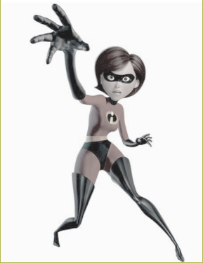
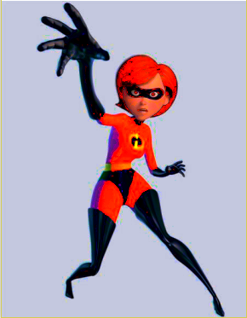
Demonstration – images
Figure3-a. image to colorize
Figure3-b. target
Figure3-c. result
Notes:
When the source image and target image have less similarity, the quality of colorization is accordingly poorer.

Slide 22
Problem and possible solution
The quality of colorization highly depends on the similarity of the source and target images.
Solution: develop neural networks and train the colorization processing with massive amount of color images [2][4][7]
3 categories of automatic coloring[6]
Transformational coloring
Image matching✔
User selection

Slide 23
Reference
[1] Reinhard, Erik, et al. "Color transfer between images."IEEE Computer Graphics and Applications21.5 (2001): 34-41.
[2] Zhang, Richard Y., Phillip Isola, and Alexei A. Efros. "Colorful Image Colorization."European Conference on Computer Vision(2016): 649-666.
[3] Luan, Qing, et al. "Natural image colorization."Eurographics Symposium on Rendering Techniques(2007): 309-320.
[4] Deshpande, Aditya, Jason Rock, and David A. Forsyth. "Learning Large-Scale Automatic Image Colorization."International Conference on Computer Vision(2015): 567-575.
[5] Gupta, Raj Kumar, et al. "Image colorization using similar images."ACM Multimedia(2012): 369-378.
[6] Kumar, Smriti, and Ayush Swarnkar. "Colorization of gray scale images in lαβ color space using mean and standard deviation."IEEE Students Conference on Electrical, Electronics and Computer Science(2012): 1-4.
[7] Nguyen, Tung Duc, Kazuki Mori, and Ruck Thawonmas. "Image Colorization Using a Deep Convolutional Neural Network.."arXiv: Computer Vision and Pattern Recognition(2016).
Notes:
1. The article pointed to by the arrow to some extent solve the problem we mentioned before – the blurry edge of objects
Its algorithm divides colorization into 2 steps – color labeling and color mapping. Pixels that should roughly share similar colors are grouped into coherent regions in the color labeling stage.
2. Mainly refer to this article

Slide 24
Reference – websites
[8] RGB转为Lab空间 https://blog.csdn.net/shamaozi/article/details/6221029
[9] Useful Color Equations
http://www.brucelindbloom.com/index.html?Equations.html

Slide 25
Thanks for listening.

